Slide 1
SYMPTOM-BASED LUNG CANCER PREDICTION Batch No.27
K.Manoj(EE21B1021)
G.Santhi swaroop(EE21B1011)
National institute of technology

Slide 2
Outline/Agenda
Introduction
Motivation
Literature Survey
Outcome of the Literature Survey
Objectives
Proposed Method
Architecture/Block Diagram
Algorithms/Flowchart
Dataset
Experimental Setup
Performance Metrics
Results
Conclusion
Future Work
References

Slide 3
Introduction
Human health is threatened by various diseases influenced by environmental conditions and lifestyle choices. Detecting and predicting such diseases early is crucial to prevent them from becoming severe.
This study seeks to determine and anticipate the prevalence of common chronic diseases among patients, with a particular focus on effectively identifying individuals with lung cancer through the use of machine learning techniques.
In our proposed model, machine learning algorithms are leveraged to offer a holistic assessment of disease prognosis based on symptoms exhibited by the patient.

Slide 4
Introduction
A dataset has been compiled, incorporating symptoms of various diseases, lifestyle choices, and information on medical consultations.
This comprehensive dataset is utilized in the general disease prediction process. Additionally, the paper includes a comparative analysis of our proposed model with several algorithms, including Naive Bayes, decision trees, and logistic regression.
After comparing the performance of the ten algorithms, one is chosen and used for the prediction of Lung Cancer in the individual.

Slide 5
Motivation
According to the World Health Organization (WHO), cancer is the first cause of death worldwide, responsible for an estimated 9.6 million deaths in 2018. Among many cancers, lung cancer (LC) tops the charts in terms of both incidence and mortality, with approximately 2.1 million new cases diagnosed and 1.8 million deaths in that year.
Early diagnosis is a major challenge since LC is often detected in its advanced stages, leading to poor prognosis. Molecular biomarkers play an important role in differentiating normal from abnormal cell states, aiding in early diagnosis, understanding cancer development, determining prognosis, and selecting treatment options.
So, there should be a method to predict lung cancer early to avoid the effects caused by its advanced stages.
This introduces a machine learning model that can predict the presence of lung cancer from the comfort of people's homes.

Slide 6
Literature Survey
Related Work-1:
Title: Random Forests and Decision Trees
Author: Jehad Ali, Rehanullah Khan, Nasir Ahmad, Imran Maqsood
Findings: Ensemble methods offer advantages such as improved predictive accuracy, model robustness, and better generalization. They are valuable in various machine learning applications. Hyperparameter tuning is essential to optimize the ensemble's performance.

Slide 7
Literature Survey
Related Work-2:
Title: Diagnosis of chronic disease in a predictive model using machine learning
algorithm
Author: I. Preethi and K. Dharmarajan
Findings: The application of machine learning algorithms enables accurate chronic disease prediction, optimizing early diagnosis and treatment. Harnessing machine learning for chronic disease diagnosis revolutionizes healthcare by enhancing predictive accuracy and enabling timely interventions.

Slide 8
Outcome of the Literature Survey/ Drawbacks
Dynamic Nature of Healthcare: Health conditions, treatments, and patterns evolve. Static machine learning models might struggle to adapt to these changes, potentially leading to inaccuracies or outdated predictions over time, requiring constant retraining and updates for sustained accuracy.
Data Quality and Bias: Machine learning models heavily depend on the quality and representativeness of the data they're trained on. Biased or incomplete datasets can lead to skewed predictions and erroneous conclusions, potentially amplifying existing healthcare disparities.

Slide 9
Objectives
The aim of this paper is to identify and predict the patients who have Lung Cancer.
This can be done by using a machine learning technique that ensures that this classification reliably recognizes people with Lung Cancer.
The proposed system provides a comprehensive disease prognosis based on the patient’s symptoms by using machine learning algorithms such as Random Forest to find the exact match in the data set and the final disease prediction outcome.
A collection of disease symptoms has been gathered for the preparation of the data set along with the person’s lifestyle habits, and details related to doctor consultations are considered in this general disease prediction.

Slide 10
Proposed Method
The proposed system provides a comprehensive disease prognosis based on the patient’s symptoms by using machine learning algorithms such as Random forest to find the exact match in the data set and the final disease prediction outcome.
Inputs given to the system are the symptoms of the individual that include Wheezing , Chest Pain , Coughing etc.
After the ensemble of decision trees according to test data, disease prediction is done based on the maximum number of yes’s and no’s which are outputs of the decision trees.
Sometimes we use the probability of yes and no also for predicting the disease.
Finally after analysing the symptoms by the algorithm , presence of the lung cancer is predicted.

Slide 11
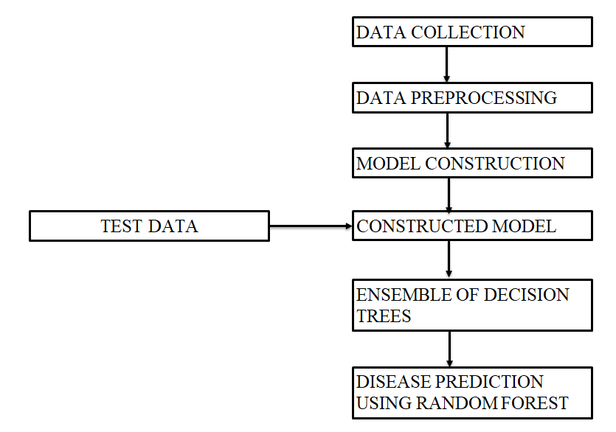
Architecture/Block Diagram

Slide 12
Algorithm(s)/ Flowchart
Gaussian Naïve Bayes Algorithm
Multinomial Naïve Bayes Algorithm
Logistic Regression
Random Forest

Slide 13
DataSet
Dataset Identification:
The dataset regarding this project has been collected from the Kaggle Webpage.
Reference Link: https://www.Kaggle.com/code/sandragracenelson/lung-cancer-prediction/input
The effectiveness of a cancer prediction system helps people to know their cancer risk at a low cost and it also helps people to make the appropriate decision based on their cancer risk status.
Total no. of attributes:16 No .of instances:284 Attribute information:
1. Gender: M(male), F(female)
2. Age: Age of the patient
3. Smoking: YES=2, NO=1.
4. Yellow fingers: YES=2, NO=1.
5. Anxiety: YES=2, NO=1.
6. Peer pressure: YES=2 , NO=1.
7. Chronic Disease: YES=2, NO=1.
8. Fatigue: YES=2 , NO=1.
9. Allergy: YES=2, NO=1.
10. Wheezing: YES=2, NO=1.
11. Alcohol: YES=2, NO=1.
12. Coughing: YES=2 , NO=1.
13. Shortness of Breath: YES=2 ,NO=1.
14. Swallowing Difficulty: YES=2, NO=1.
15. Chest pain: YES=2, NO=1.
16. Lung Cancer: YES, NO.

Slide 14
Experimental Setup
Data Collection and Preprocessing: Data set has been collected from a web source. Preprocessing steps like excluding ineffective columns, handling outliers, null values, etc have been performed.
Feature Selection and Engineering: Identifying the most relevant features for the model and creating new features that might enhance predictive performance.
Model Selection: Choosing suitable algorithms or models based on the problem domain and dataset characteristics. This involves selecting the right models to experiment with, such as Logistic regression, Random forest, Multinomial naïve Bayes, Gaussian naïve Bayes, etc.
Training and Validation: Splitting the data into training, validation, and test sets. Training models on the training set, and evaluating performance on the test set to assess generalization.
Performance Metrics: Select appropriate evaluation metrics (e.g., accuracy, precision, recall, F1-score) to measure the model's performance and compare different models.

Slide 15
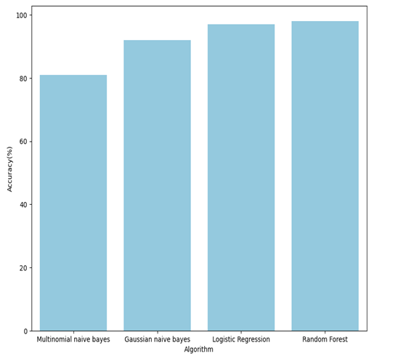
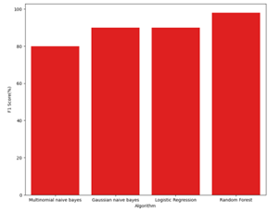
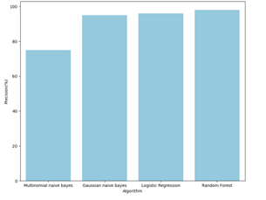
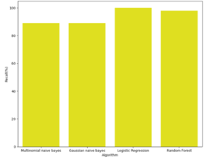
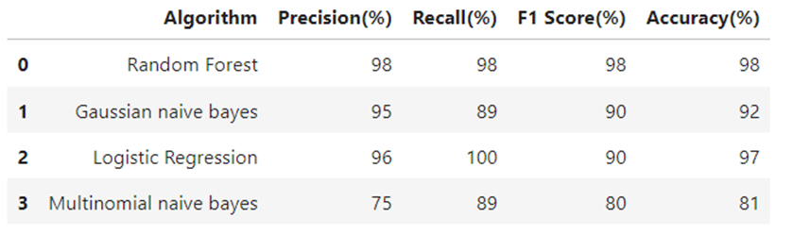
Performance Metrics
S.no | Algorithm | Precision(%) | Recall(%) | F1-Score(%) | Accuracy(%)
1 | Multinomial Naïve Bayes | 75 | 89 | 80 | 81
2 | Gaussian Naïve Bayes | 95 | 89 | 90 | 92
3 | Logistic Regression | 96 | 100 | 90 | 97
4 | Random Forest | 98 | 98 | 98 | 98

Slide 16
Results
We've gathered user-reported symptoms to ascertain their presence.
These symptoms were translated into integers and processed using the Random Forest machine learning model.
This analysis determines if an individual is likely to have lung cancer based on the symptoms provided.

Slide 17
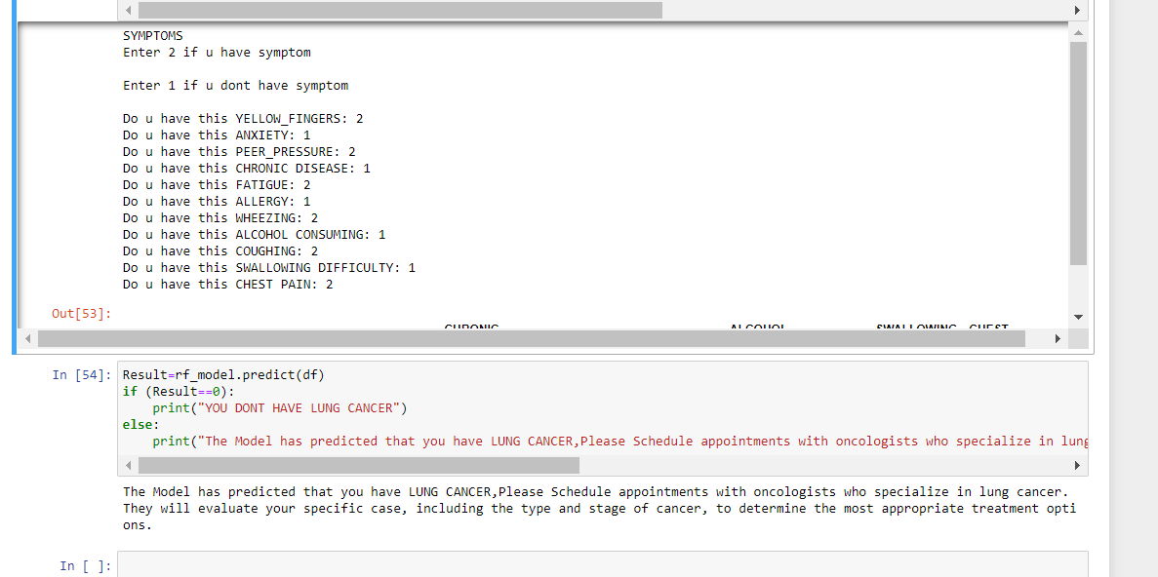
Results

Slide 18
Conclusion
This model introduces an approach for detecting and forecasting the existence of lung cancer in individuals by employing machine learning techniques, specifically Random forest algorithms.
Within this model, the effectiveness of the suggested model is evaluated in comparison to alternative algorithms, including Multinomial Naïve Bayes, Gaussian Naïve Bayes, and logistic regression. The outcomes demonstrate that the proposed system attains an accuracy rate of 98%, surpassing the performance of the other three algorithms.
It is strongly anticipated that the introduction of this system can contribute to the early diagnosis of Lung cancers, thereby mitigating associated risks, while also potentially lowering the overall costs related to diagnosis, treatment, and medical consultations

Slide 19
Future Work
Enhancing this approach involves integrating image processing algorithms like CNN for in-depth analysis, especially with X-rays.
While the current model focuses on predicting lung cancer, expanding it to predict various diseases simultaneously could be beneficial.
Incorporating deep learning algorithms offers a more detailed and accurate analysis, especially in handling medical imaging data, allowing for precise diagnostic results.

Slide 20
References
[1] J. Bras. Patol,” Lung cancer biomarkers, A literature review”.
[2] Jehad Ali, Rehanullah Khan, Nasir Ahmad, Imran Maqsood, ” Random Forests and Decision Trees”.
[3] Maher Maalouf,”Logistic Regression in Data Analysis: An Overview”
[4] M. Vijay Anand, B. KiranBala, S. R. Srividhya, Kavitha C, Mohammed Younu, Md Habibur Rahman, “Gaussian Na¨ıve Bayes Algorithm: A Reliable TechniqueInvolved in the Assortment of the Segregation in Cancer”
[5] Shuo Xu , Yan Li , Wang Zheng ,“Bayesian Multinomial Naïve Bayes Classifier to Text Classification”
[6] R. Ge, R. Zhang, and P Wang, “Prediction of chronic diseases with multi-label neural network,” IEEE Access, vol. 8, pp. 138210–138216, 2020.
[7] H. MacLeod, S. Yang, O. Kim, C. Kay, and S. Natarajan, “Identifying rare diseases from behavioural data: a machine learning approach,” in Proceedings of the 2016 IEEE First International Conference on Connected Health: Applications, Systems and Engineering Technologies (CHASE), pp. 130–139, IEEE,Washington, DC, USA, June 2016.
[8] M. A. Myszczynska, P. N. Ojamies, A. M. B. Lacoste et al., “Applications of machine learning to diagnosis and treatment of neurodegenerative diseases,” Nature Reviews Neurology, vol. 16, no. 8, pp. 440–456, 2020.

Slide 21
References
[9] I. Preethi and K. Dharmarajan, “Diagnosis of chronic disease in a predictive model using machine learning algorithm,” in Proceedings of the 2020 International Conference on Smart Technologies in Computing,Electrical and Electronics (ICSTCEE), pp. 191–96, IEEE, Bengaluru, India, October 2020.
[10] J. Wiens and E. S Shenoy, “Machine learning for healthcare: on the verge of a major shift in healthcare epidemiology,” Clinical Infectious Diseases, vol. 66, no. 1, pp. 149–153, 2018.
[11] S. Swaminathan, K. Qirko, T. Smith et al., “A machine learning approach to triaging patients with chronic obstructive pulmonary disease,” PLoS One, vol. 12, no. 11, Article ID e0188532, 2017.
[12] Z. Wang, J. W. Chung, X. Jiang, Y. Cui, M. Wang, and A. Zheng, “Machine learning-based prediction system for chronic kidney disease using associative classification technique,” International Journal of Engineering & Technology, vol. 7, pp. 1161–1167, 2018.
[13] A. Kumar and A. Pathak, “A machine learning model for early prediction of multiple diseases to cure lives,” Turkish Journal of Computer and Mathematics Education (TURCOMAT), vol. 12, no. 6, pp. 4013–4023, 2021.
[14] C. Kalaiselvi, “Diagnosing of heart diseases using average K-nearest neighbor algorithm of data mining,”in Proceedings of the 2016 3rd International Conference on Computing for Sustainable Global Development (INDIACom), pp. 3099–3103, IEEE, New Delhi, India, March 2016.

